Slide 1
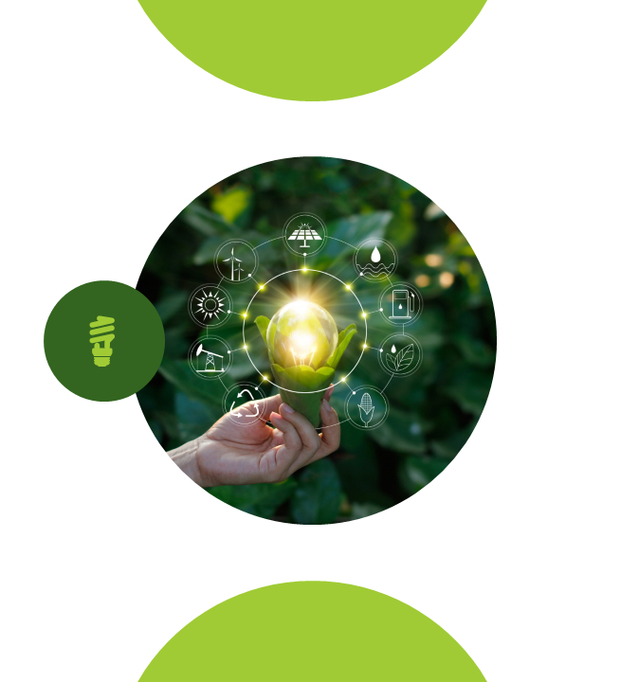

Evapotranspiration modeling using Explainable AI
Presented by
SASMITA SAHOO (210301120081)
MAMALI SAHOO(210301120142)
Guided By
Dr . Bibhuti Sahoo

Slide 2

INTRODUCTION
MOTIVATION & OBJECTIVE
BLOCK DIAGRAM
EXPLAINABLE AI
SHAP VALUE
DATA DESCRIPTION
DATA PREPROCESSING
EXPLORATORY DATA ANALYSIS
MODELLING
EXPERIMENT WITH SHAP VALUE
RESULT AND DISCUSSION
CONCLUSION
REFERENCES
FUTURE SCOPE
Contents

Slide 3

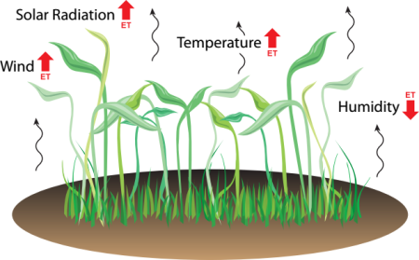
Introduction
Evapotranspiration is the sum of evaporation from the land surface and transpiration from plants. Evapotranspiration helps in understanding water balance and irrigation needs. It is influenced by factors such as temperature, humidity, wind speed, and solar radiation.
Explainable AI (XAI) refers to methods and techniques in artificial intelligence that make the outcomes of models understandable to humans. XAI aims to address the "black box" nature of many AI models, providing insights into how decisions are made.

Slide 4
Motivation & Objective
Evapotranspiration (ET) modeling is crucial for water resource management, agriculture, and climate adaptation. Traditional methods struggle with accuracy. Using Explainable AI (XAI) can improve ET predictions and provide clear insights into the factors influencing it, enabling better decision-making.
Develop a machine learning model for ET prediction.
Use XAI techniques to identify and explain key factors influencing ET.

Slide 5
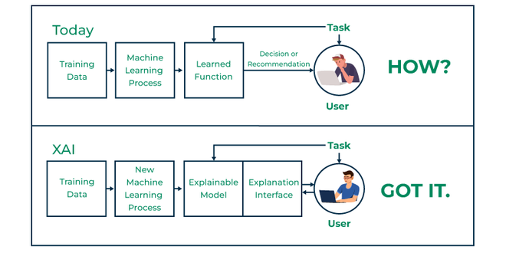
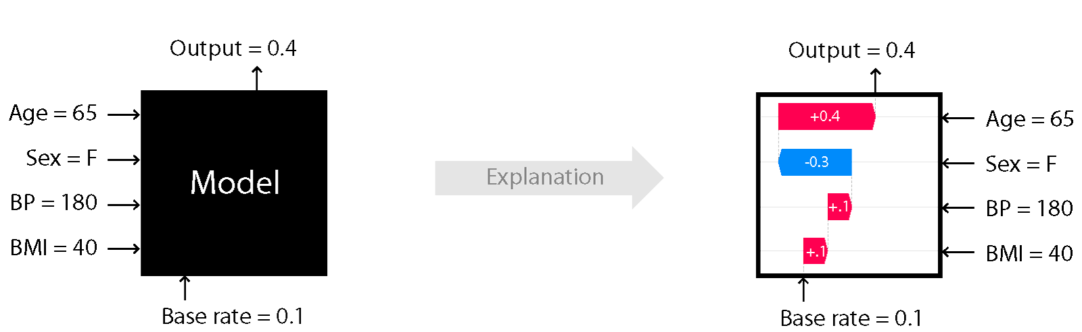
Explainable AI
Explainable AI (XAI) refers to a set of processes and methods designed to make the outputs of artificial intelligence (AI) systems understandable to human.

Slide 6
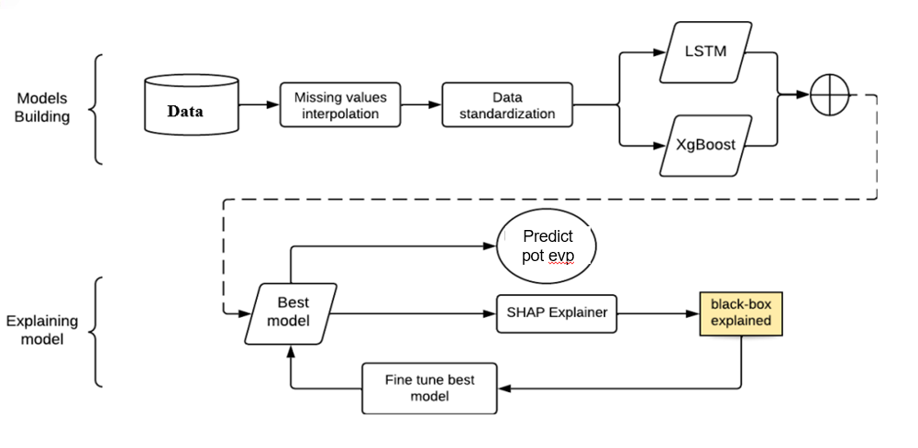
Block diagram

Slide 7
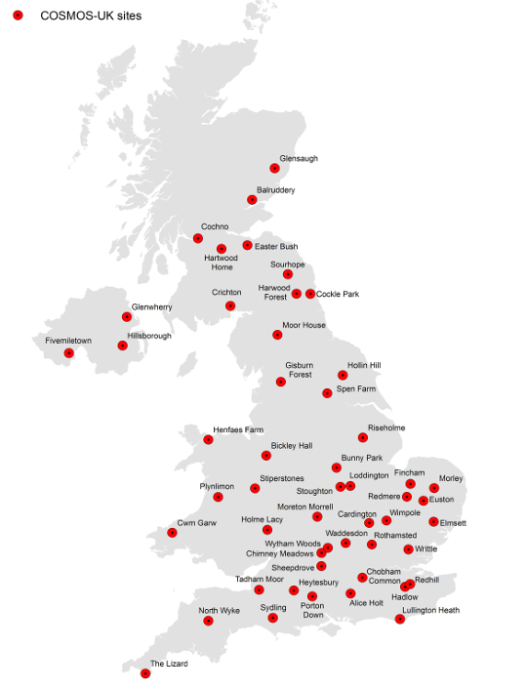
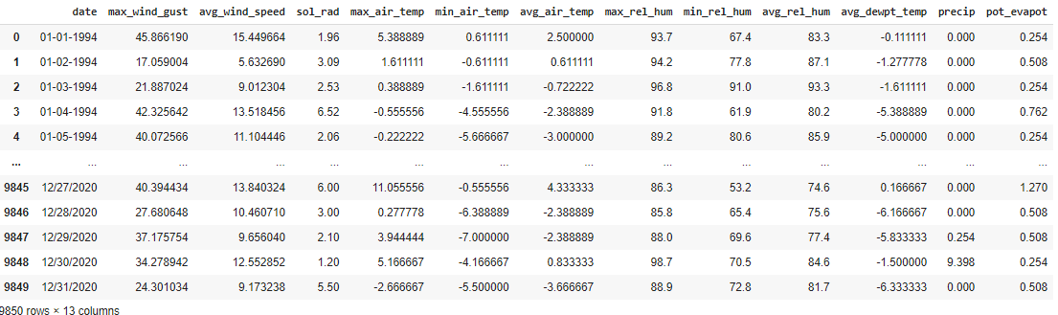
Dataset Description
Data Source: United States Geological Survey website
Number of Records: 9,850
Number of Attributes: 13
Temporal Range: 1994 to 2020
Data Characteristics: Continuous numeric values
Target Variable: Potential Evapotranspiration

Slide 8
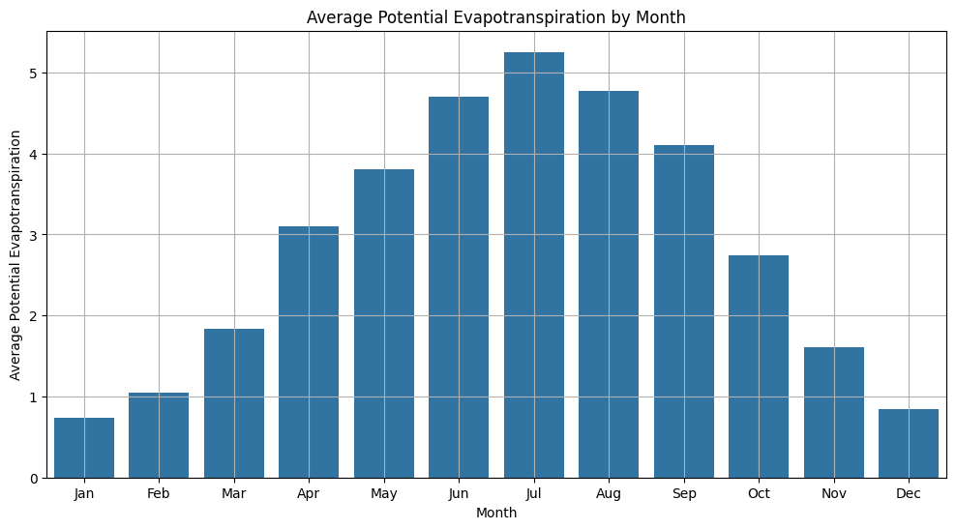
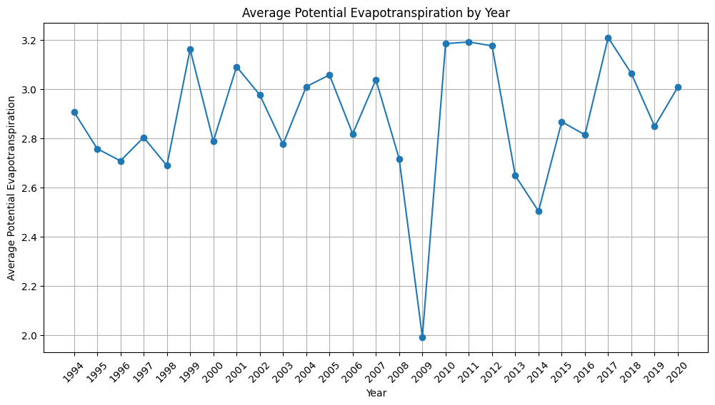
Exploratory data analysis
Month wise analysis
Year wise pot evapotranspiration analysis

Slide 9
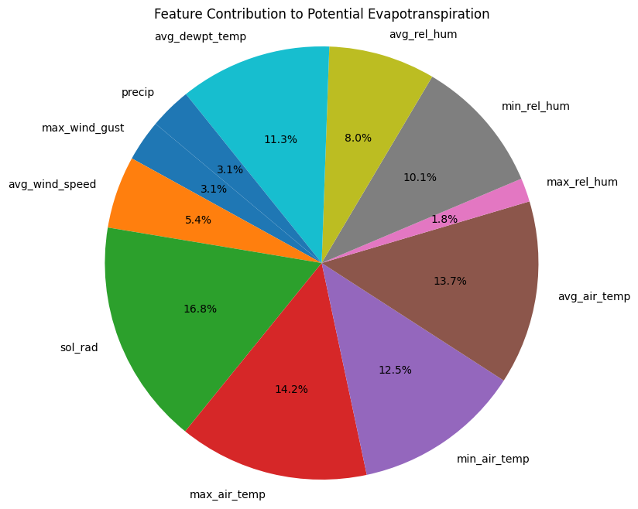
Exploratory data analysis
Feature Contribution for evapotranspiration

Slide 10
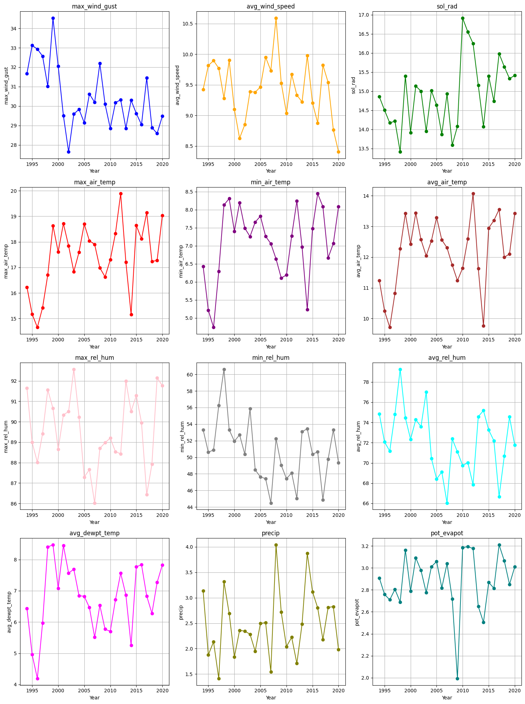
Feature data analysis
Plot between different features and year

Slide 11
Feature data analysis
Plot between different features and year

Slide 12
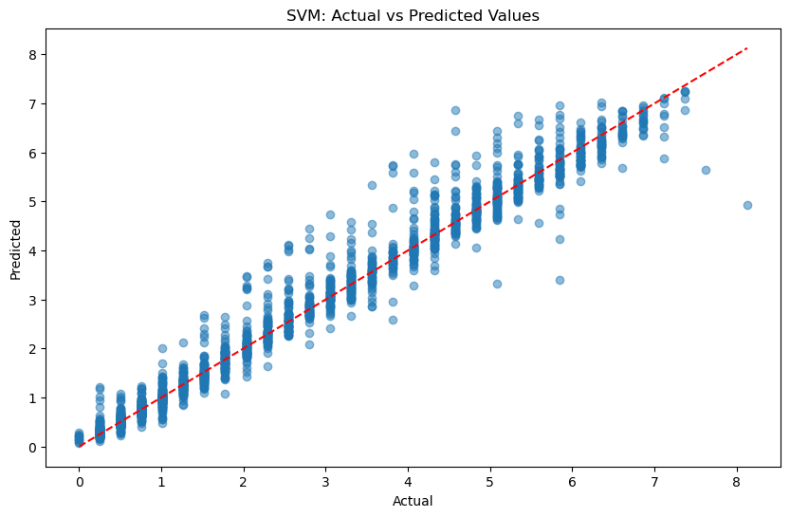
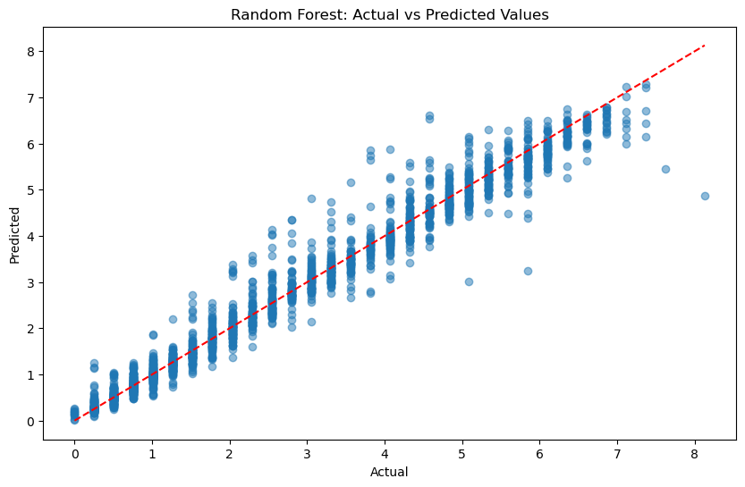
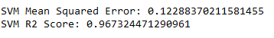
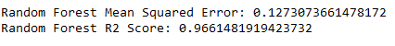
Applying Machine learning model
Experimentation with Random forest and SVM

Slide 13
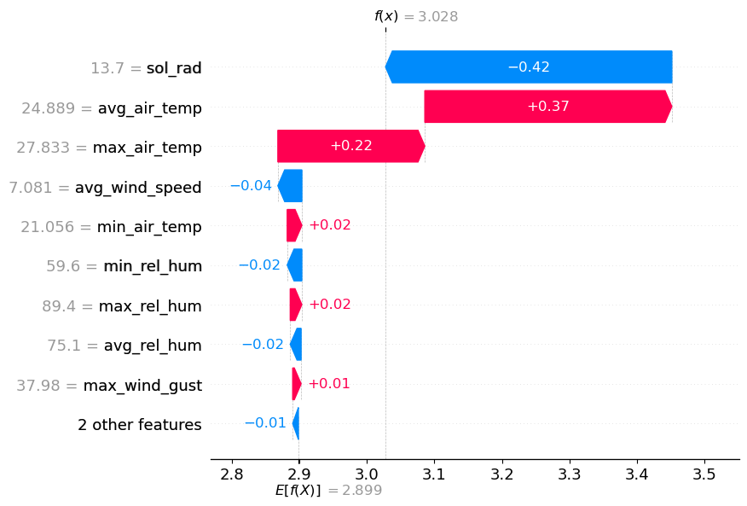
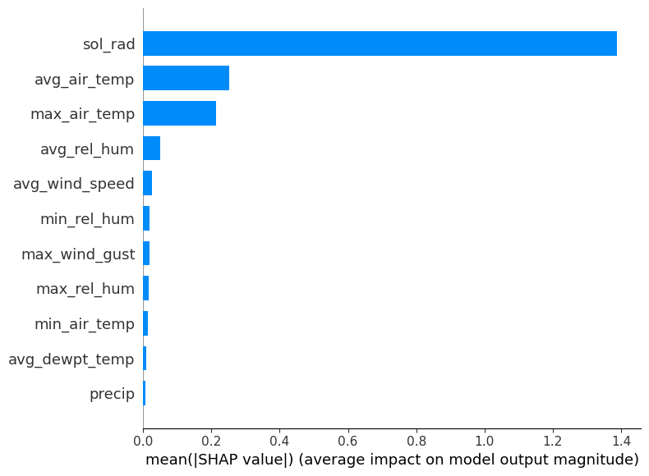
SHAP Value Experimentation
SHAP summery plot
SHAP bar plot

Slide 14
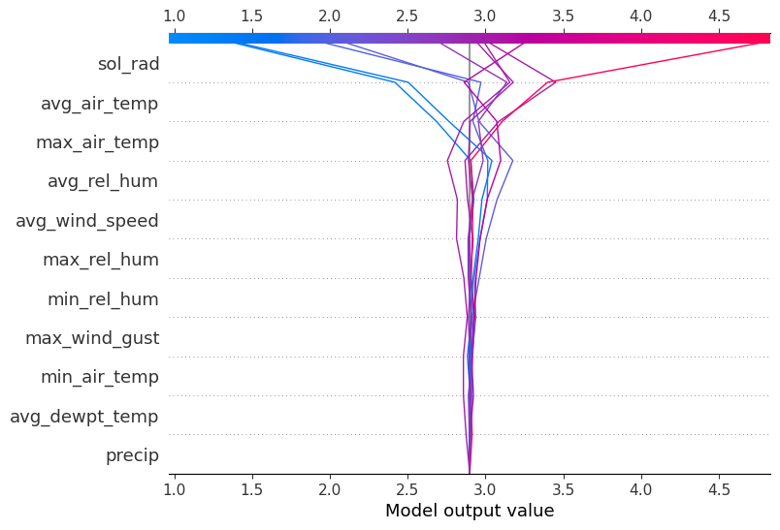
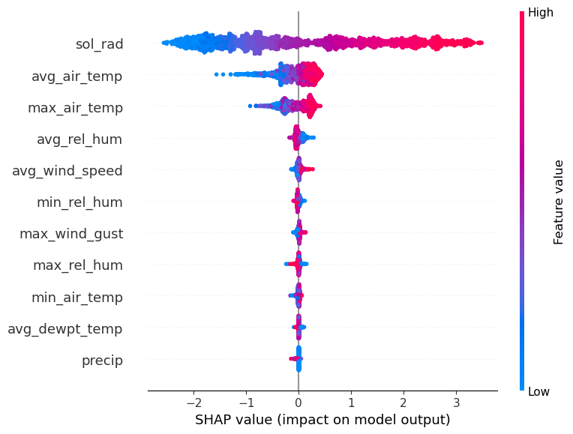
SHAP Value Experimentation
SHAP decision plot
SHAP waterfall plot

Slide 15
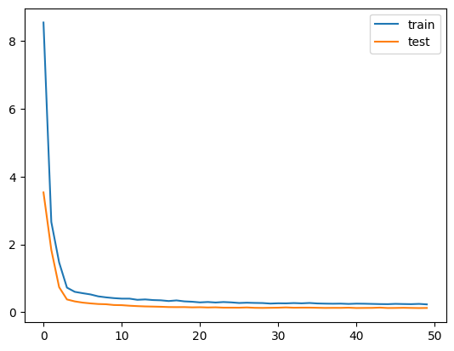
Result and Discussion
By applying LSTM lag value with time series data and Shap ,we got the MSE value as 0.12 . The feature “Soil radiation” is affecting most where as the feature “precipation” affects least the potential evapotranspiration.
The next 5 years expected pot_evapotranspiration rate ranges between [0.4165600000000002, 0.4191000000000002].
Mean Squared Error: 0.12598512042389728

Slide 16
Conclusion
This study demonstrated the effectiveness of machine learning models, particularly in LSTM, in predicting potential evapotranspiration. The comparative analysis highlighted the superior performance emphasizing its suitability for tabular time series data. By experimenting SHAP for global explanations we provided a comprehensive understanding of the model's decision-making process.

Slide 17
REFERENCE
[1] Ben Abdallah, E., Grati, R., and Boukadi, K. (2023). Towards an explainable irrigation scheduling approach by predicting soil moisture and evapotranspiration via multi-target regression. Journal of Ambient Intelligence and Smart Environments, 15:89–110.
[2] Chakraborty, D., Başagaoglu, H., and Winterle, J. (2021). Interpretable vs. non-interpretable machine learning models for data-driven hydro-climatological process modeling. Expert Systems with Applications, 170:114498.
[3] Di Bucchianico, A. (2008). Coefficient of Determination (R²). John Wiley and Sons, Ltd.
[4] Fereres, E. and García-Vila, M. (2018). Irrigation Management for Efficient Crop Production. In Meyers, R. A., editor, Encyclopedia of Sustainability Science and Technology, pages 1–17. Springer, New York, NY.
[5]Ghosal, S., Blystone, D., Singh, A. K., Ganapathysubramanian, B., Singh, A., and Sarkar, S. (2018). An explainable deep machine vision framework for plant stress phenotyping. Proceedings of the National Academy of Sciences of the United States of America, 115(18):4613–4618. Place: Washington. Publisher: Natl Acad Sciences.
[6] Goap, A., Sharma, D., Shukla, A. K., and Rama Krishna, C. (2018). An IoT-based smart irrigation management system using machine learning and open-source technologies. Computers and Electronics in Agriculture, 155:41–49.
[7] Goldstein, A., Fink, L., Meitin, A., Bohadana, S., Lutenberg, O., and Ravid, G. (2018). Applying machine learning on sensor data for irrigation recommendations: revealing the agronomist’s tacit knowledge. Precision Agriculture, 19(3):421–444.

Slide 18
TIMELINE
WORK | DESCRIPTION | TIME | PROGRESS
Team members selection | Selecting 2 members for our project | 2 days | Completed
Project selection and finalization | Finalised the topic of Evapotranspiration modelling using Explainable AI | 5 days | Completed
Data Collection | USGS | 4 days | Completed
Collection some Previous Research Paper | To study more think | 6 -7 days | Completed
Data Preprocessing | Missing Data ,Date conversion.etc. | 2 days | Completed
Model using | LSTM+SHAP Value | 2 months | Continue
Accuracy Analysis | Mean Squared Error | On the process | Continue

Slide 19

THANK YOU

